Slide 1
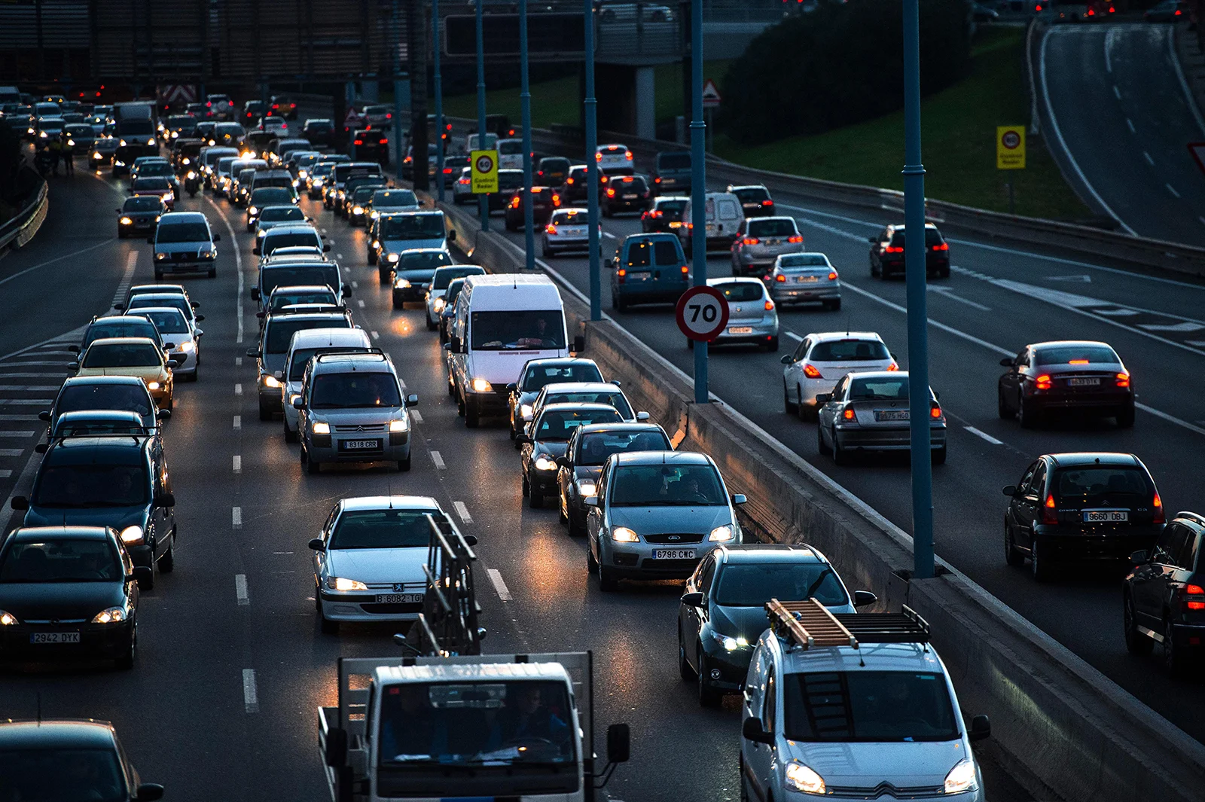
AUTOMATIC NUMBER PLATE RECOGNITION
GUIDE NAME: Mr. P.B. ARAVIND PRASAD.,M.Tech
(AP/AI)
TEAM MEMBERS:
M. KANNIGA SARASWATHY (811721243024)
P. MADHUMITHA (811721243026)
R. MONISH VIDYARTHI (811721243035)
A. SUBALATHA (811721243054)

Slide 2
OBJECTIVE:
Automatic Number Plate Recognition (ANPR) is a technology utilized for various applications such as traffic management, law enforcement, and parking management.
ANPR systems employ computer vision and deep learning techniques to detect and recognize license plates from images or video streams.
YOLOv8, an advanced object detection algorithm, is chosen for this project due to its improved performance and efficiency.
This project focuses on implementing an ANPR system using YOLOv8 within MATLAB.
The goal is to showcase YOLOv8's capability in accurately detecting and recognizing license plates while ensuring robustness to different environmental factors like lighting conditions, plate sizes, and font variations.

Slide 3
EXISTING SYSTEM:
In the existing system, traditional ANPR systems might rely on simpler algorithms for license plate detection and recognition. These systems may not be as robust to varying environmental conditions and might struggle with accurately detecting and recognizing license plates in challenging scenarios such as low-light conditions, varying plate sizes, or font variations. Additionally, traditional methods might require extensive hand-engineering of features and may not fully leverage the power of deep learning techniques.
PROPOSED SYSTEM:
The proposed system uses a super-smart tool called YOLOv8, along with MATLAB, to quickly and accurately find license plates. YOLOv8 is like a genius at spotting plates even in tricky situations like bad lighting or different fonts. By using YOLOv8, we hope to make the system awesome at finding license plates in real life. And because we're doing this in MATLAB, it's easy to use and play around with other image stuff. Basically, we want to show how cool YOLOv8 is for tasks like managing traffic, catching bad guys, and sorting out parking.

Slide 4
LITERATURE SURVEY:
S.NO | PAPER TITLE | AUTHOR NAME | YEAR PUBLISHED | TECHNIQUE USED | MERITS | DEMERITS
1. | A review paper on Automatic Number Plate Recognition System using Machine Learning algorithms | Miss. Shraddha S. Ghadage, Mr. Sagar R. Khedkar | 2019 | KNN, SVM, K-Means Algorithm, Deep Learning, ELM | Comprehensive Overview, Comparison of Algorithm, Identification of Trends | Lack of Standardization, Complexity of Algorithms
2. | Survey Paper on Automatic Number Plate Recognition | A.S. Teli, S.S. Bandekar, D.S. Landage, S.J. Gore, S.S. Saptute | 2022 | Open CV, KNN, Matlab, OCR | Better Detection Rates, Effective Character Recognition, High Accuracy | Lack of Specifics, Unclear Contribution, Language and Structure

Slide 5
S.NO | PAPER TITLE | AUTHOR NAME | YEAR PUBLISHED | TECHNIQUE USED | MERITS | DEMERITS
3. | Automatic Number Plate Recognition: A Detailed Survey of Relevant Algorithms | Lubna, Naveen Mufti, Syed Afaq Ali Shah | 2021 | CV Algorithm, Deep Learning Techniques, Neural Network | Comprehensive Survey, Performance Comparison, Focus on CV | Hardware Dependency, Performance Limitations, Complexity
4. | Relevance of Automatic Number Plate Recognition Systems in Vehicle Theft Detection | Kamalesh Kumawat, Anubha Jain, Neha Tiwari | 2023 | Matlab, Extreme Learning Machine, CNN, OCR | Focus on ANPR Systems, Comparison of Algorithms, Application Areas | Lack of depth on technology, Lack of Specific examples

Slide 6
S.NO | PAPER TITLE | AUTHOR NAME | YEAR PUBLISHED | TECHNIQUE USED | MERITS | DEMERITS
5. | Vehicle Number Plate Detection Using Image Processing | Abhay Singh, Anand Kumar Gupta, Anmol Singh, Anuj Gupta, Sherish Johri | 2018 | OCR, Matlab, Deep Learning Techniques | Enhance Surveillance, Security, Supports Law Enforcement, Potential Privacy | Limited by image quality and conditions, Dependent on continuous technological Maintenance

Slide 7
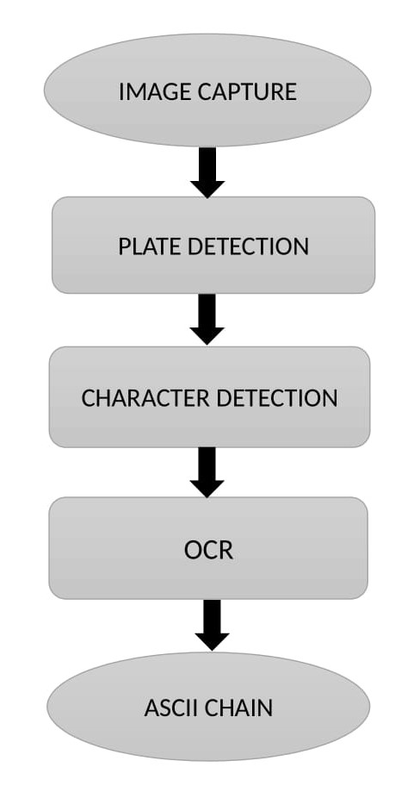
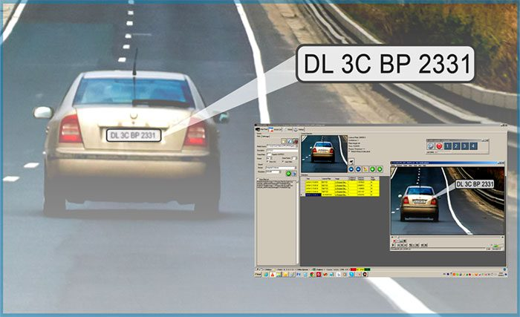
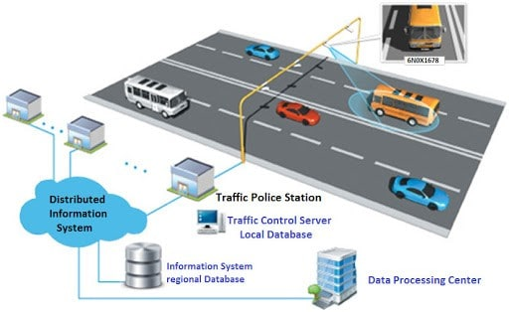
FLOW DIAGRAM :

Slide 8
SYSTEM SPECIFICATION:
Operating System: Works on Windows, macOS, and Linux.
Hardware Requirements: Needs a decent computer with enough memory and processing power.
Camera Requirements: Works with different types of cameras, like CCTV or webcams.
Connectivity: Can connect to cameras through USB, Wi-Fi, or network.

Slide 9
SOFTWARE SPECIFICATION:
MATLAB: Uses MATLAB for building the ANPR system.
YOLOv8: Integrates YOLOv8 for detecting license plates.
Deep Learning Toolbox: Uses MATLAB's Deep Learning Toolbox for training YOLOv8.
Image Processing Toolbox: Uses MATLAB's Image Processing Toolbox for image enhancements.
GUI Development: Builds a user-friendly interface using MATLAB's App Designer.

Slide 10
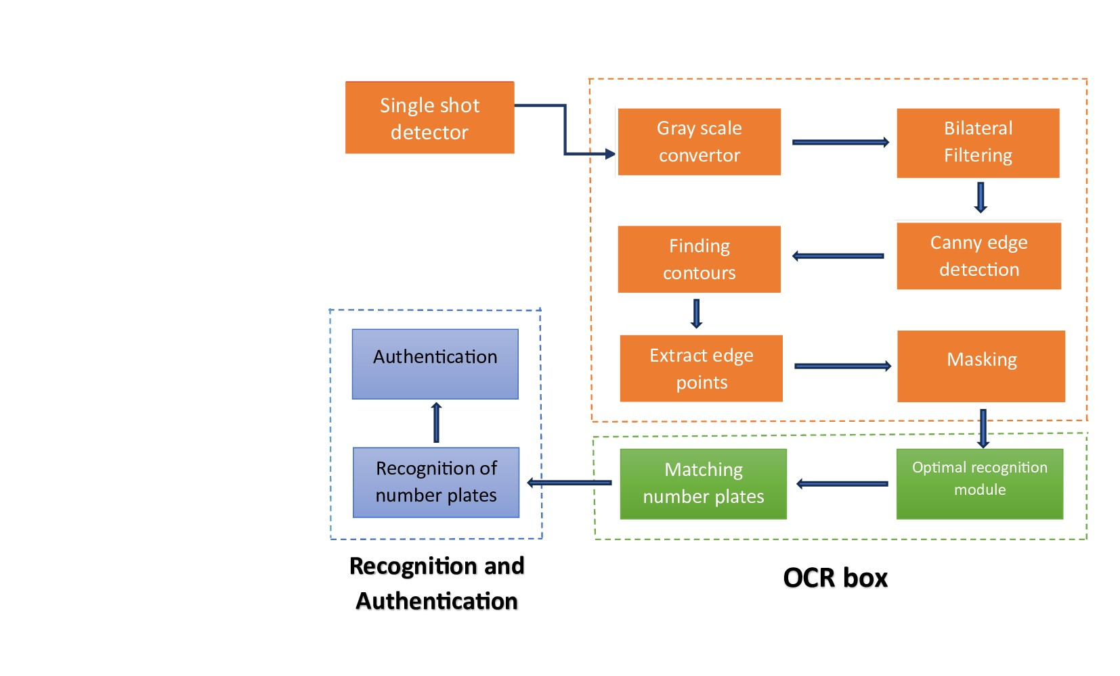
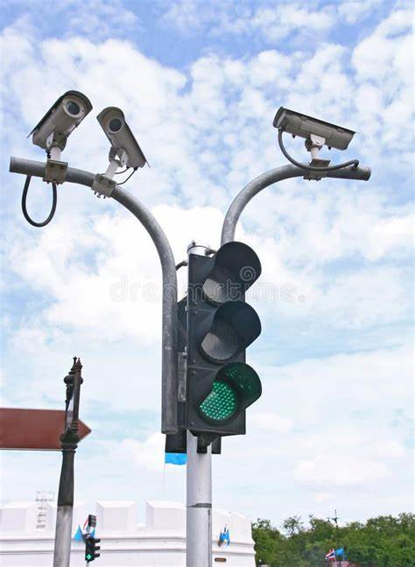
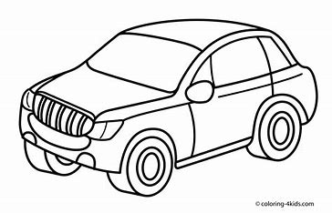
ARCHITECTURAL DIAGRAM:

Slide 11
MODULES:
Input and Preprocessing Module
1
User Interface Module
2
Object Detection Module
6
Alerting and Output Module
5
3
License Plate Recognition Module
4
Database Module

Slide 12
MODULE 1: INPUT AND PREPROCESSING MODULE
DESCRIPTION:
The input module captures input images or video streams from cameras installed at various locations.
The preprocessing module processes the input images to enhance their quality and make them suitable for further analysis.
FEATURES:
It supports multiple camera inputs, handles different image formats, and ensures a continuous flow of data to the rest of the system.
It is designed to handle various types of images and conditions, ensuring that the input data is standardized and optimized for the object detection module.

Slide 13
MODULE 2: OBJECT DETECTION MODULE (YOLOv8)
DESCRIPTION:
The YOLOv8 object detection module is responsible for detecting and localizing objects in the input images. In this case, it is specifically used to detect license plates in the images.
FEATURES:
It is known for its speed and accuracy, making it ideal for real-time applications. It can detect multiple objects in a single image and has been trained on a large dataset to recognize license plates accurately.

Slide 14
MODULE 3: LICENSE PLATE RECOGNITION MODULE
DESCRIPTION:
Once the license plates are detected, the license plate recognition module extracts the alphanumeric characters from the plates using optical character recognition (OCR) techniques.
FEATURES:
It is designed to handle various fonts, sizes, and styles of characters typically found on license plates. It can also handle distorted or partially obscured characters to improve recognition accuracy.

Slide 15
MODULE 4: DATABASE MODULE
DESCRIPTION:
The database module stores information about the detected license plates, including the extracted characters and the corresponding timestamps and locations.
FEATURES:
It supports efficient data storage and retrieval operations, ensuring that the system can handle large volumes of data. It can also support data encryption and security features to protect sensitive information.

Slide 16
MODULE 5: ALERTING AND OUTPUT MODULE
DESCRIPTION:
The alert module generates alerts or notifications based on predefined criteria, such as detecting a stolen vehicle or a vehicle with outstanding violations.
The output module displays the results of the ANPR system, such as the detected license plates and any associated information, on a user interface or dashboard.
FEATURES:
It supports customizable alert rules and thresholds, allowing the system to be tailored to specific requirements.
It supports real-time updates and can display data from multiple sources simultaneously.

Slide 17
MODULE 6: USER INTERFACE MODULE
DESCRIPTION:
Easy Ice is a middleware that can be used to integrate different components of the ANPR system, such as the object detection module and the database module, into a cohesive system.
FEATURES:
It supports various communication protocols, such as TCP/IP and MQTT, and can be configured to work with different hardware and software platforms. It also provides logging and monitoring features to help debug and optimize the system.

Slide 18
ADVANTAGES
YOLOv8 is fast and efficient, enabling real-time video stream processing.
YOLOv8 accurately detects objects, including license plates, ensuring correct identification.
YOLOv8 is suitable for devices with limited resources.
Easily customizable for different ANPR applications and environments.
YOLOv8 reduces the cost of implementing an ANPR system.
Capable of handling large traffic volumes

Slide 19
APPLICATIONS
Traffic Management
Law Enforcement
Parking Management
Border Control and Security
Electronic Toll Collection
Retail and Marketing
Smart cities
Parking Violation Enforcement

Slide 20
CONCLUSION:
ANPR system using YOLOv8 accurately detects and recognizes license plates from images or videos, serving various applications like toll collection and traffic management.
Integration of deep learning models with preprocessing and post-processing techniques ensures efficient and reliable license plate detection and recognition, contributing to improved transportation infrastructure and public safety.

Slide 21
REFERENCES
P. Kulkarni, A. Khatri, P. Banga and K. Shah, "Automatic Number Plate Recognition (ANPR) system for Indian conditions", 2009.
A. Beibut, K. Magzhan and K. Chingiz, "Effective algorithms and methods for automatic number plate recognition", 2014.
B. Pechiammal and J. A. Renjith, "An efficient approach for automatic license plate recognition system", 2017.
B. V. Kakani, D. Gandhi and S. Jani, "Improved OCR based automatic vehicle number plate recognition using features trained neural network", 2017.
F. Fajas, F. Yousuf, P. R. Remya, A. P. Pavanan, S. Ambadiyil and V. Swaminathan, "Automatic Number Plate Recognition for Indian standard number plates", 2012.

Slide 22
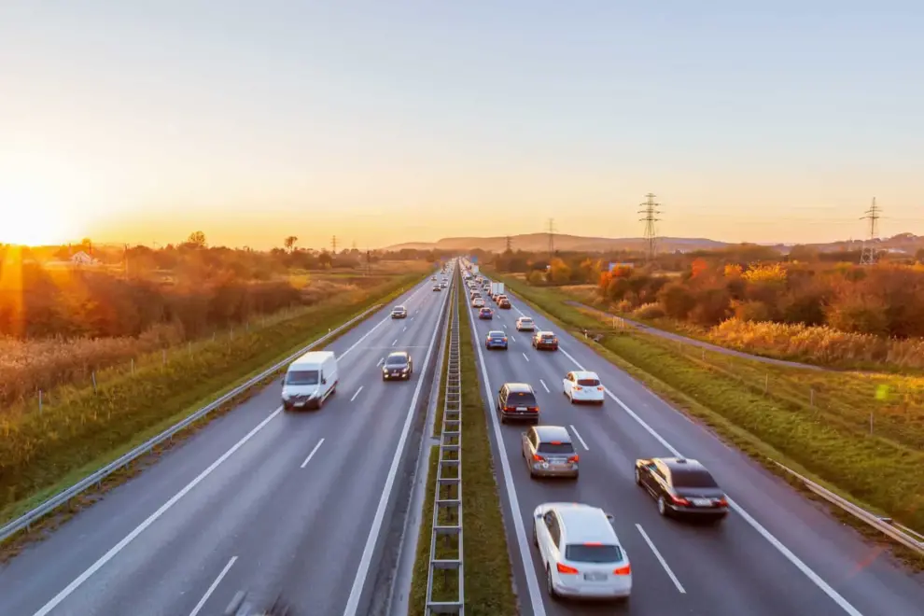
THANK YOU!!!

